Slide 1
Transactions In MicroServices
siva@way2learnonline.com

Slide 2
SAGAS
A saga is a sequence of local transactions.
Each local transaction updates the database and publishes a message or event to trigger the next local transaction in the saga.
If a local transaction fails because it violates a business rule then the saga executes a series of compensating transactions that undo the changes that were made by the preceding local transactions.
siva@way2learnonline.com
Notes:
https://microservices.io/patterns/data/saga.html

Slide 3
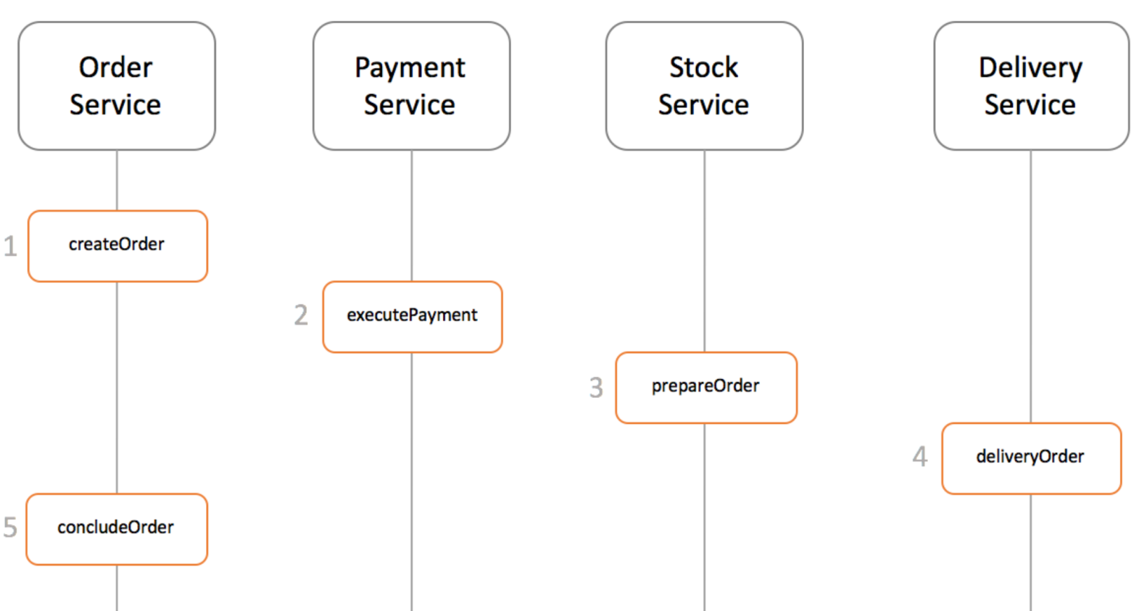
siva@way2learnonline.com

Slide 4
Ways to implement Coordination Sagas
There are two ways of coordination sagas:
  Choreography - each local transaction publishes domain events that trigger local transactions in other services
  Orchestration - an orchestrator (object) tells the participants what local transactions to execute
siva@way2learnonline.com

Slide 5
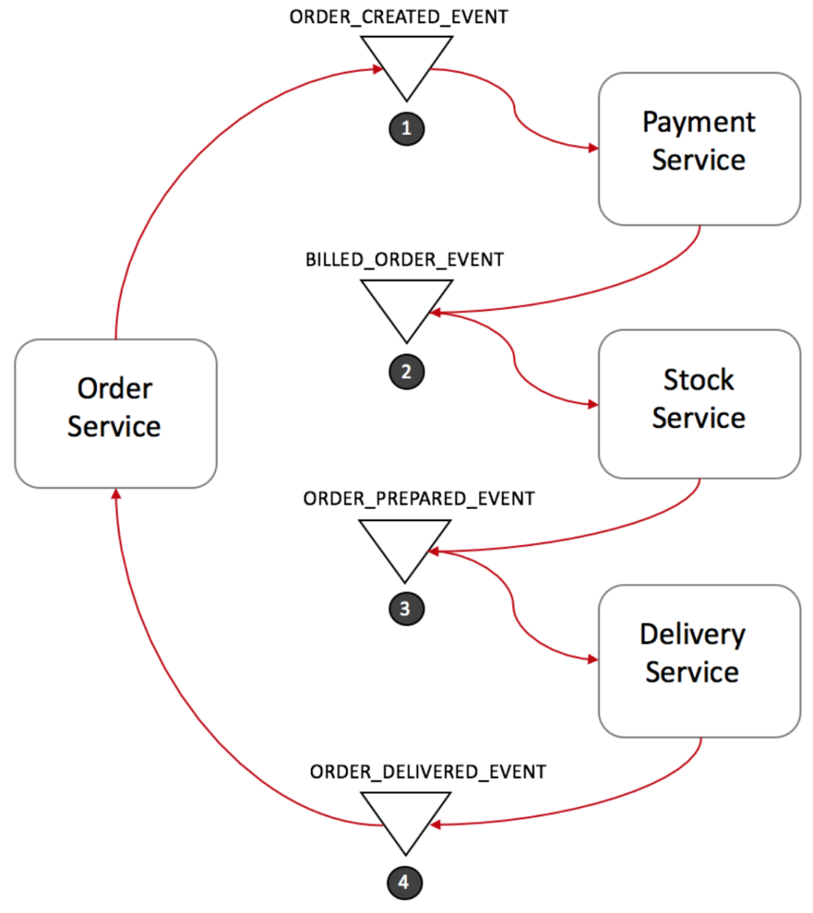
Choreography based saga
siva@way2learnonline.com

Slide 6
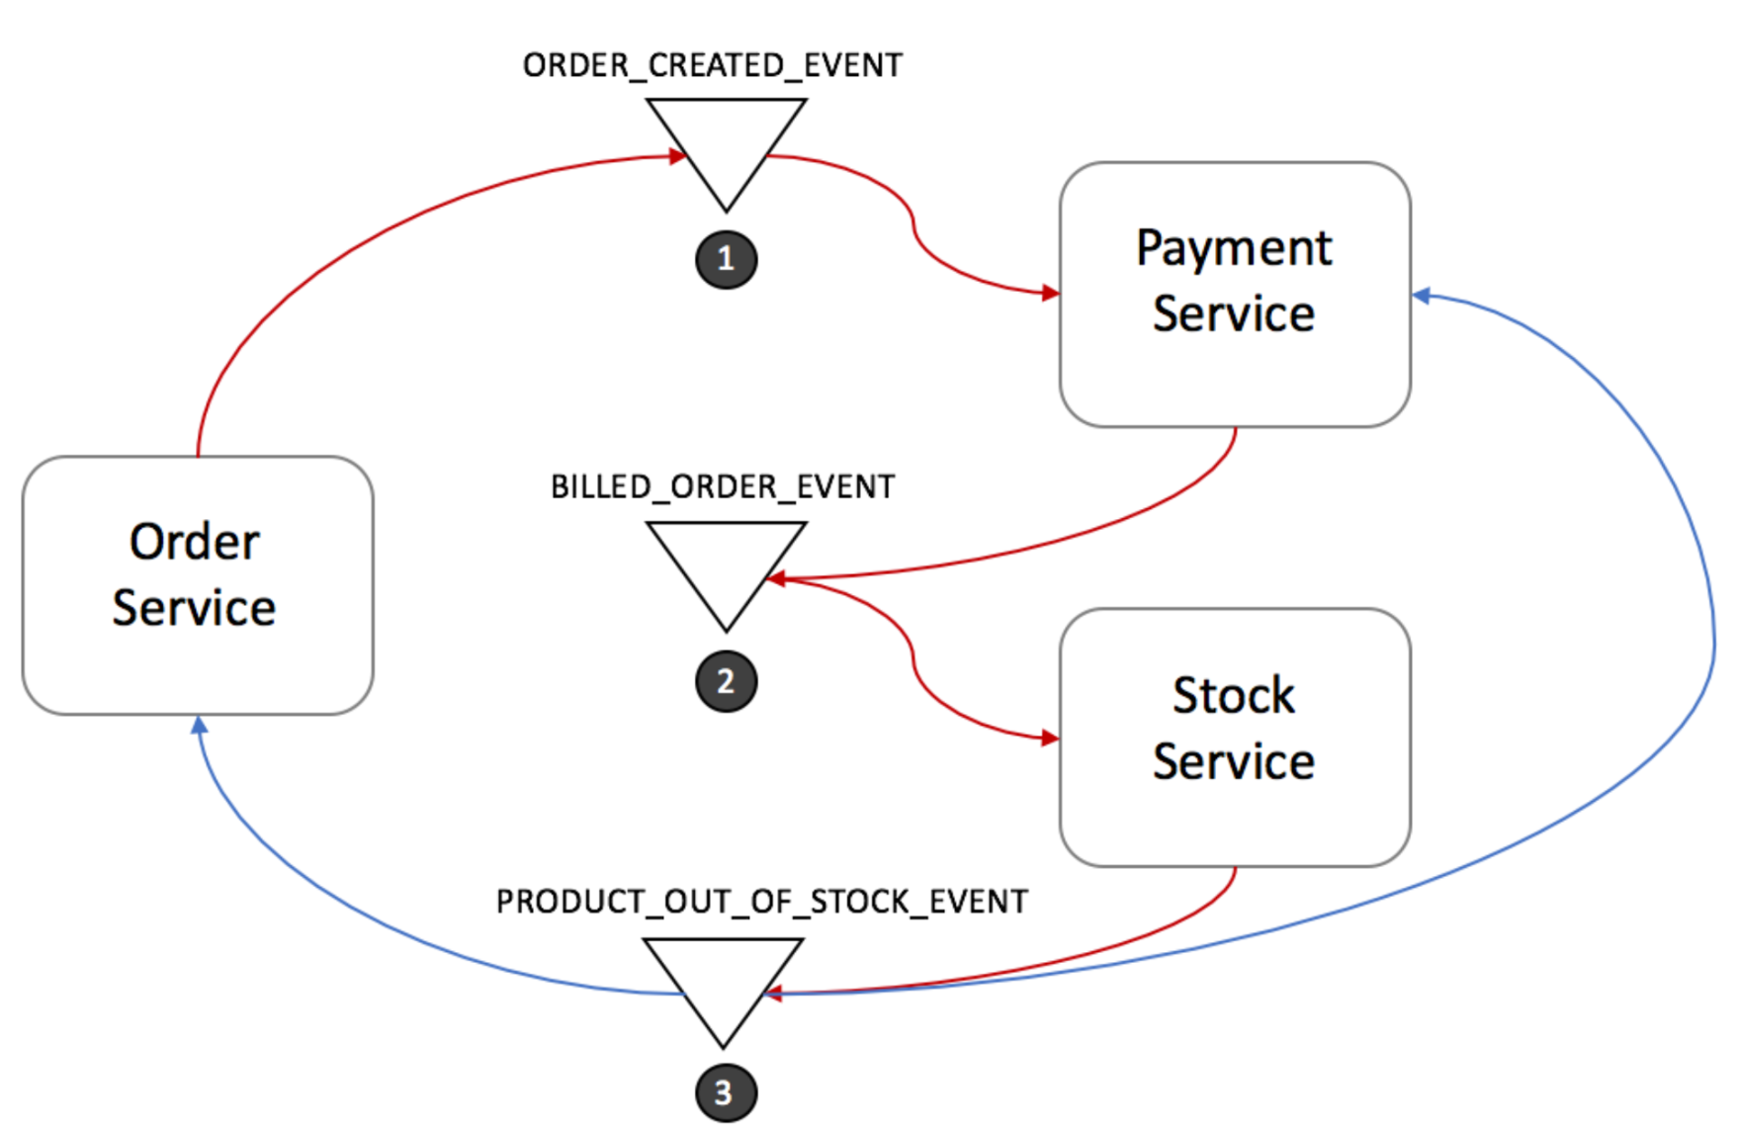
siva@way2learnonline.com

Slide 7
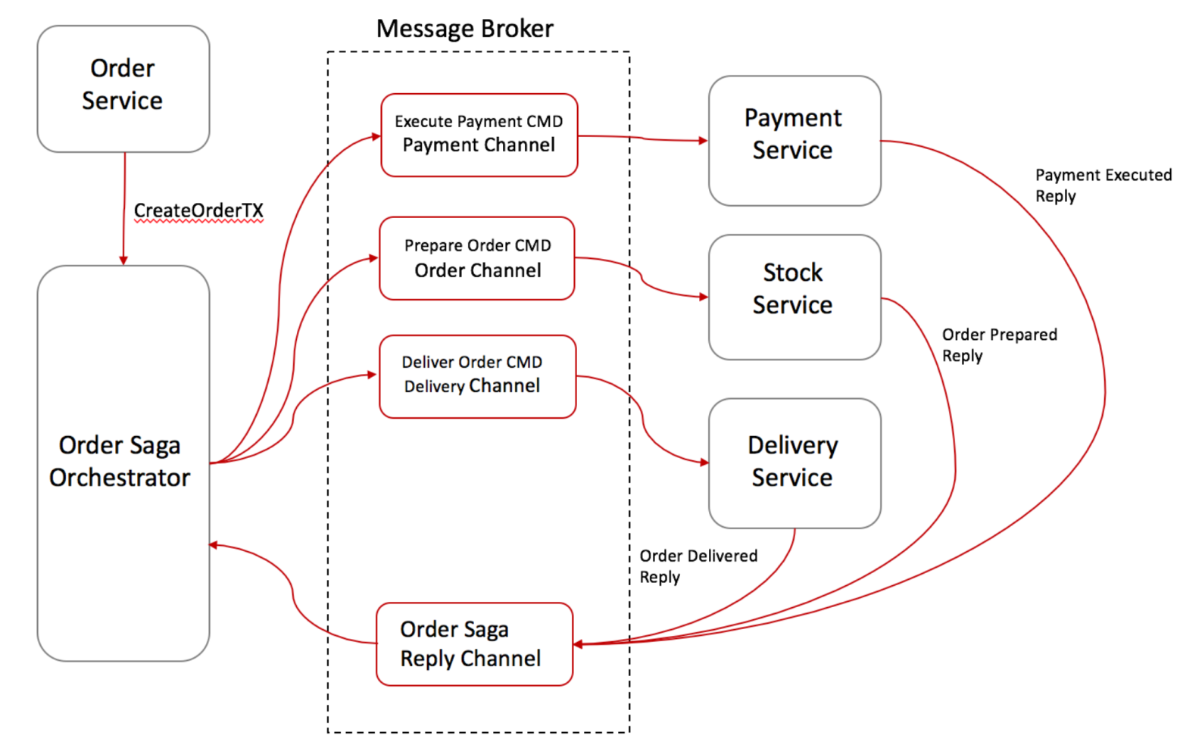
Orchestration-based saga
siva@way2learnonline.com

Slide 8
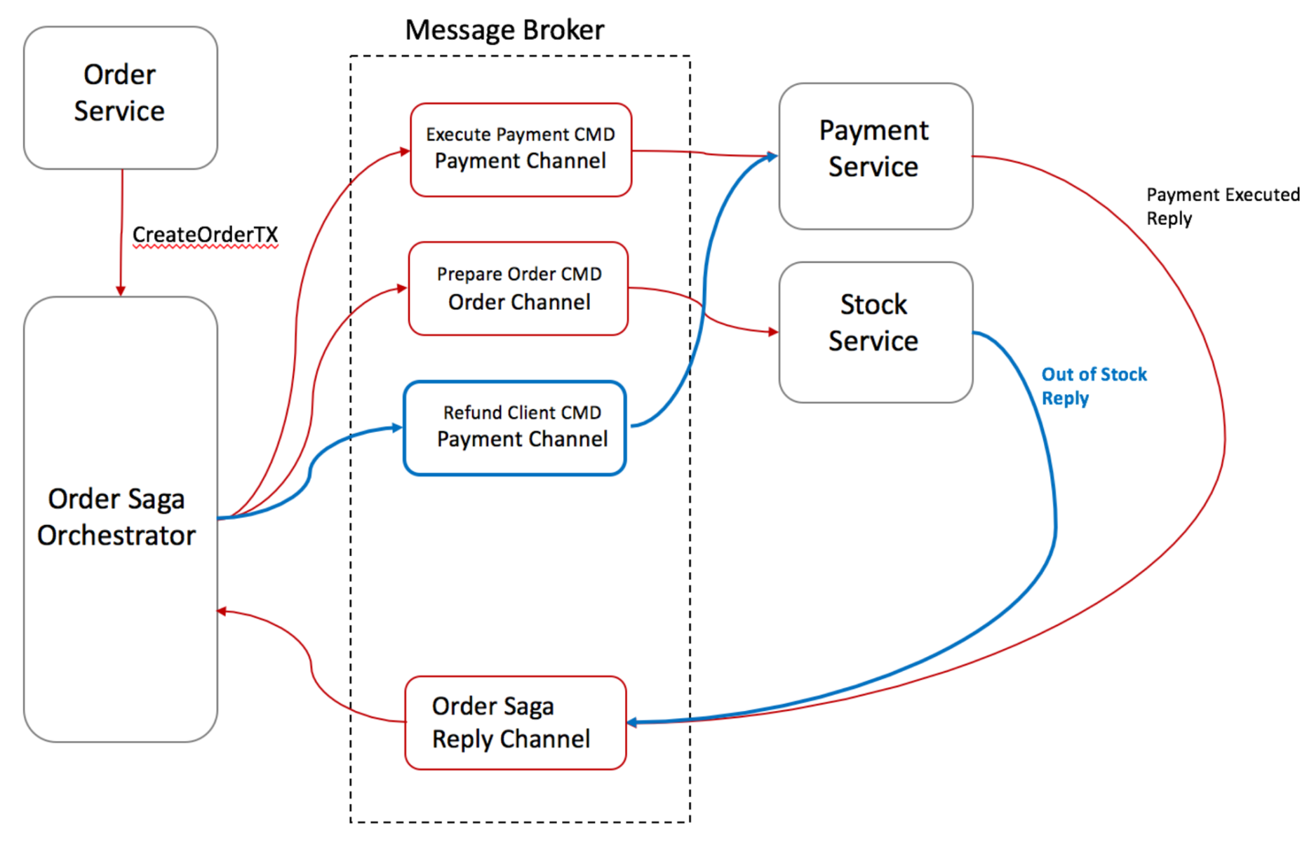
Rolling back in Saga’s Command/Orchestration
siva@way2learnonline.com

Slide 9
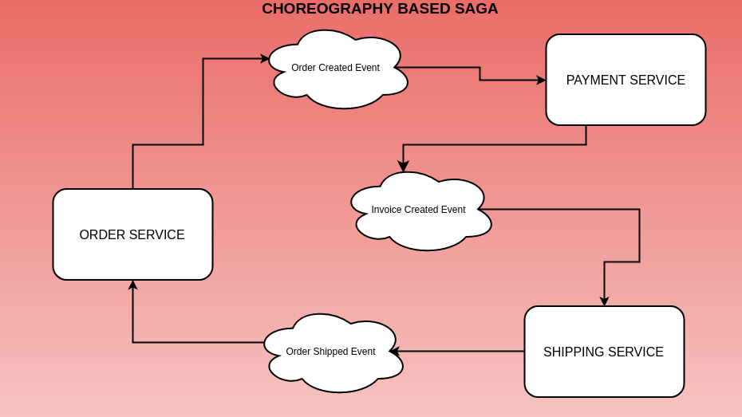
siva@way2learnonline.com

Slide 10
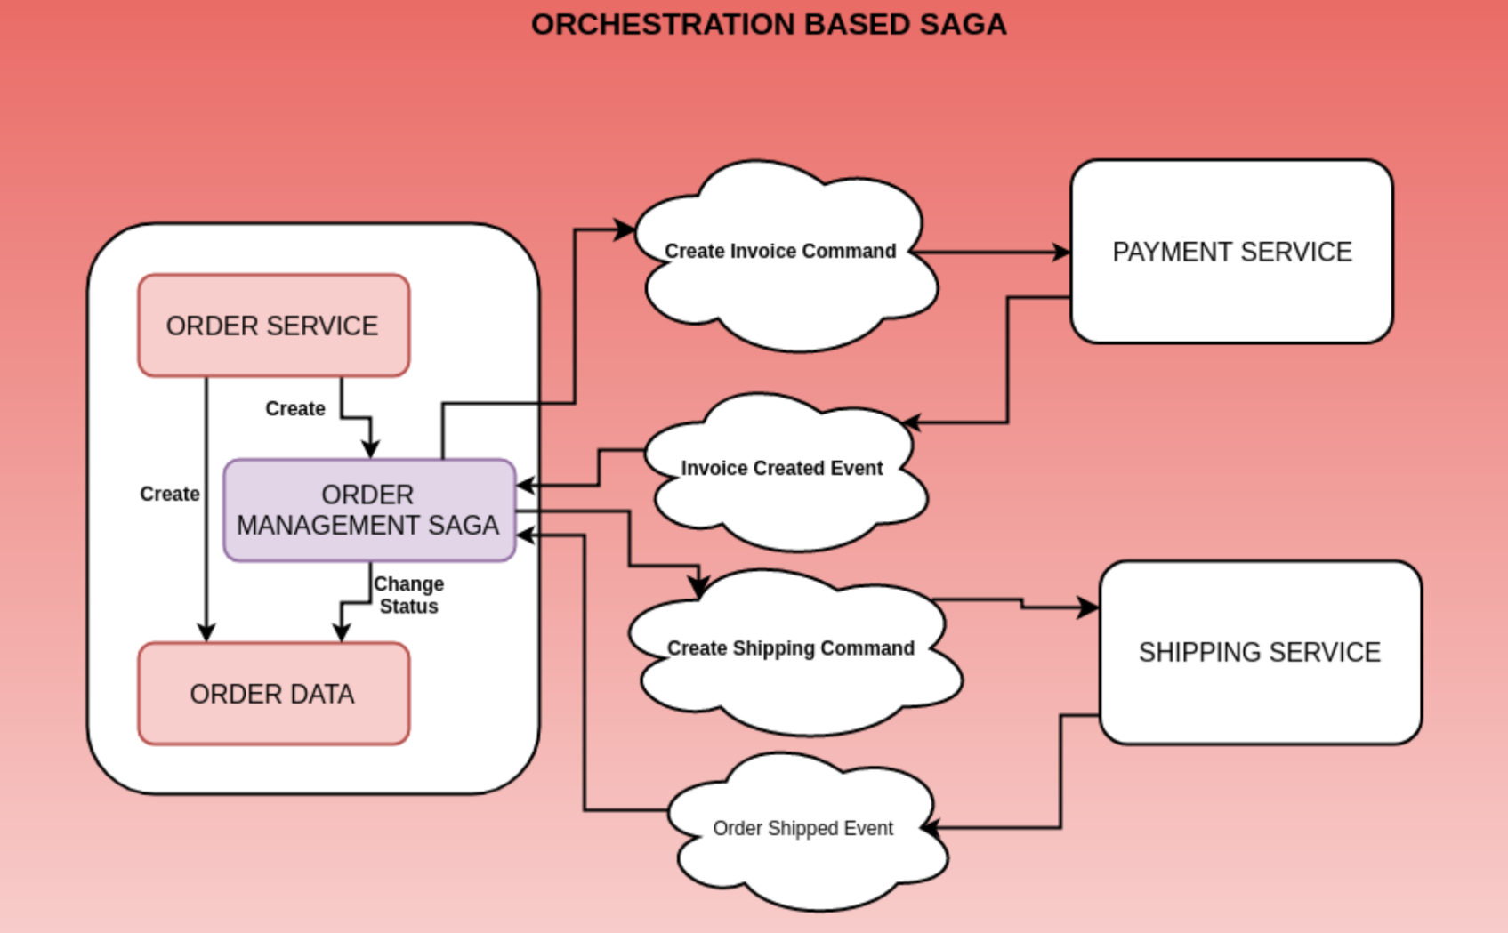
siva@way2learnonline.com

